Slide 1
Publish Subscribe Model

Slide 2
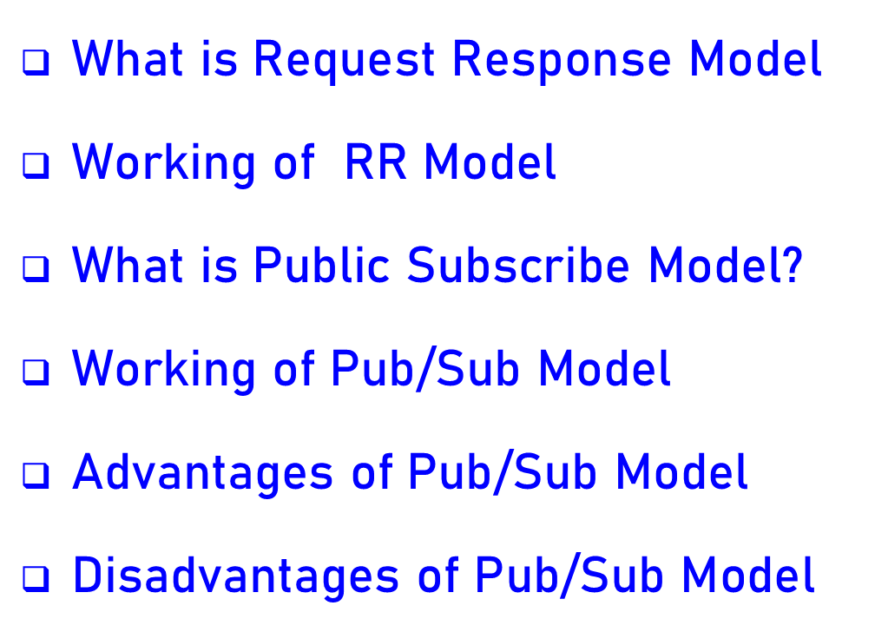
Contents

Slide 3
What is Request Response Model
Request–response, or request–reply, is one of the basic method use to communicate computers with each other, in which the first computer send a request for some data and the second responds to the request. Usually, there is a series of such interchanges until the complete message is sent; browsing a web page is an example of request–response communication.
This pattern is especially common in client–server architectures.

Slide 4
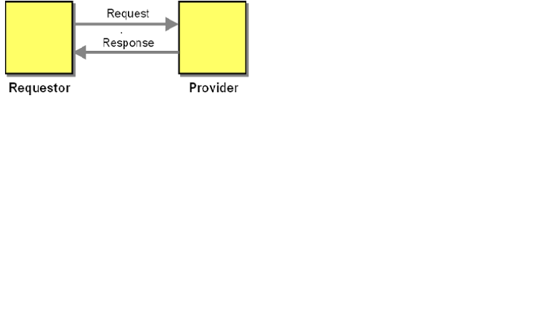
Working of request response Model

Slide 5

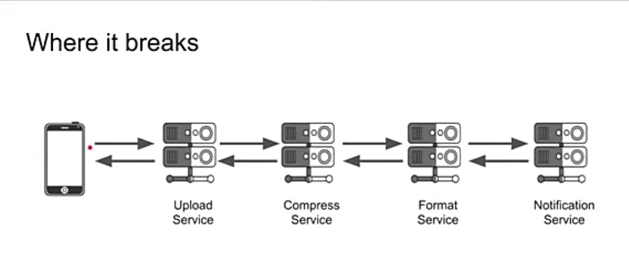
Example of request response Model

Slide 6
Disadvantages of RR Model
Bad for multiple receiver
High Coupling
Client/Server have to be running
Chaining, circuit breaking

Slide 7
What is Pub/Sub Model?
A Publish Subscribe Architecture is a messaging pattern where the publishers broadcast messages, with no knowledge of the subscribers.
Similarly the subscribers ‘listen’ out for messages regarding data that they are interested in without any knowledge of who the publishers are.

Slide 8
Definition
Pub/sub is shorthand for publish/subscribe messaging, an asynchronous communication method in which messages are exchanged between applications without knowing the identity of the sender or recipient.

Slide 9
Terminology used in Pub/Sub
Four core concepts make up the pub/sub model:
Topic/Logical Channel – An intermediary channel that maintains a list of subscribers to relay messages to that are received from publishers.
Message – Messages sent to a topic by a publisher which has no knowledge of the subscribers.
Publisher – The application that publishes a message to a topic.
        Subscriber – An application that registers itself with the desired topic in order to receive the appropriate messages.

Slide 10
Continue…
There are two common forms of filtering:
topic-based and content-based.
In a topic-based system, messages are published to "topics" or logical channels. Subscribers in a topic-based system will receive all messages published to the topics to which they subscribe. The publisher is responsible for defining the topics to which subscribers can subscribe.
In a content-based system, messages are only delivered to a subscriber if the attributes or content of those messages matches constraints defined by the subscriber. The subscriber is responsible for classifying the messages.

Slide 11
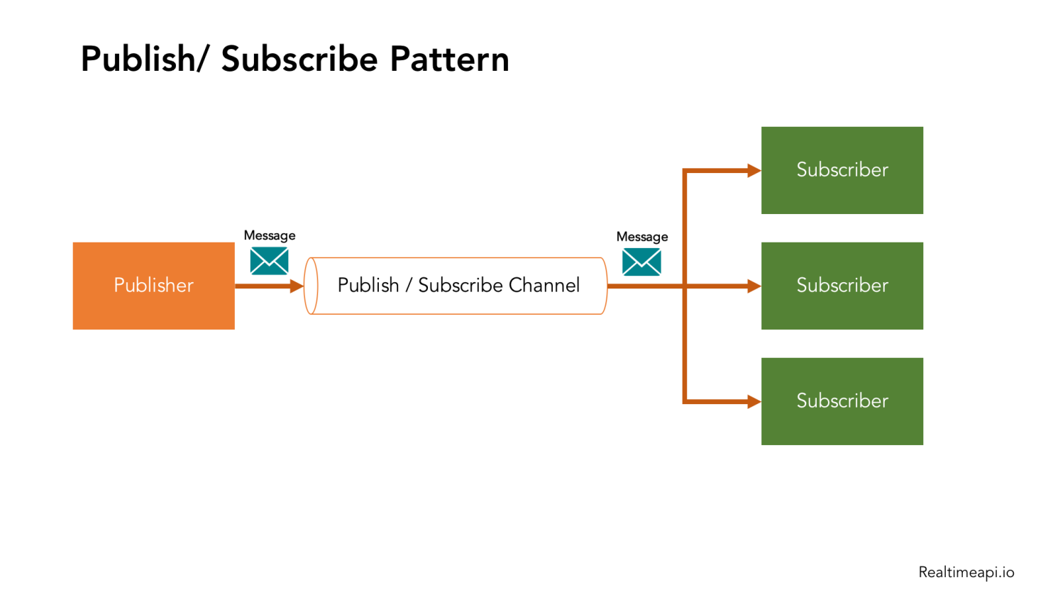
Working of Pub/Sub Model

Slide 12
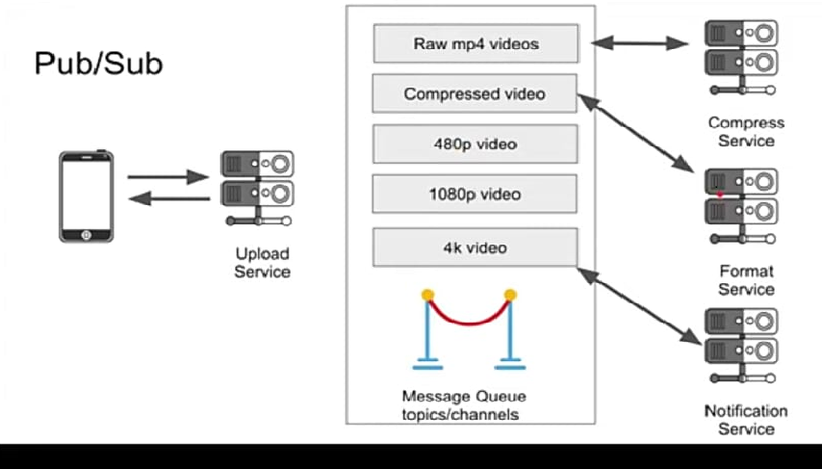
Example of Pub/Sub Model

Slide 13
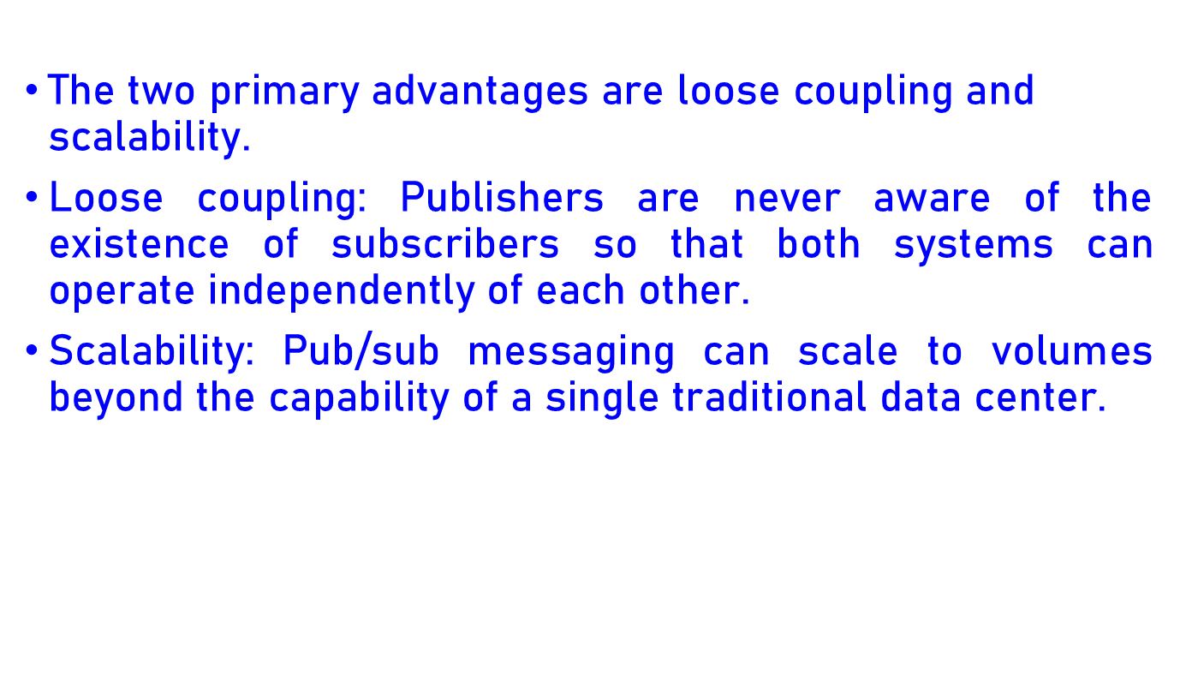
Advantages of Pub/Sub Model

Slide 14
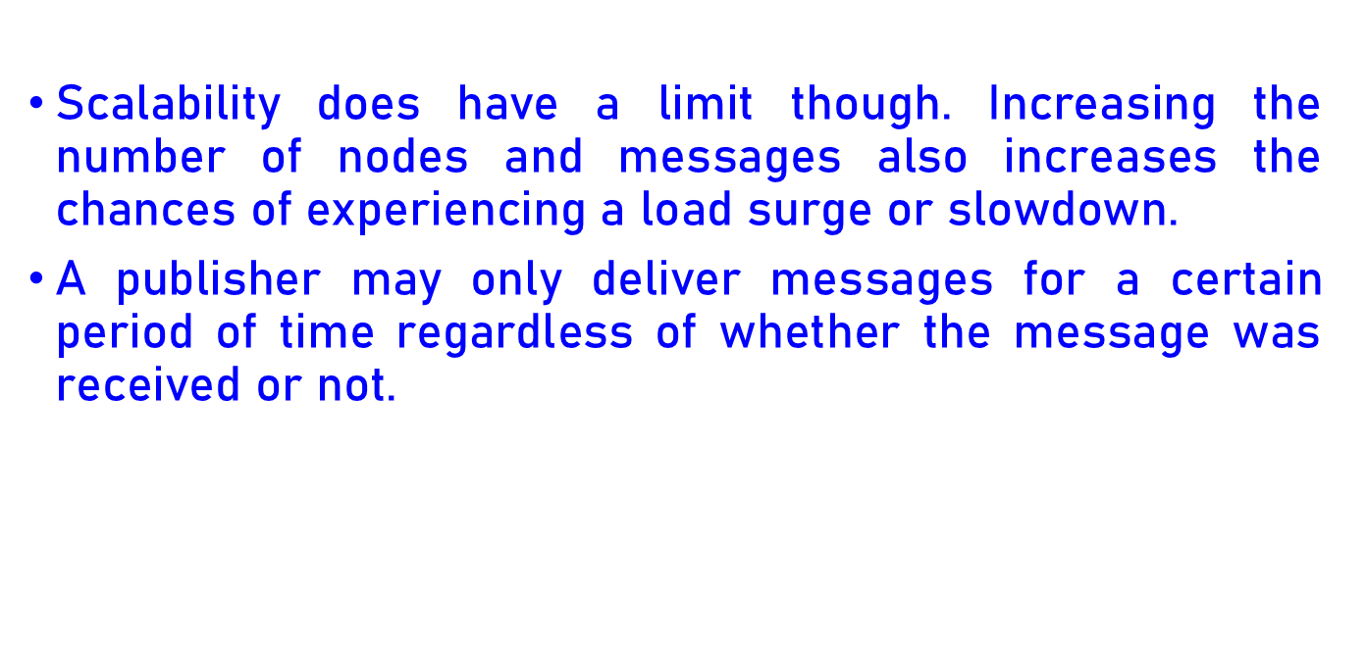
Disadvantages of Pub/Sub Model

Slide 15
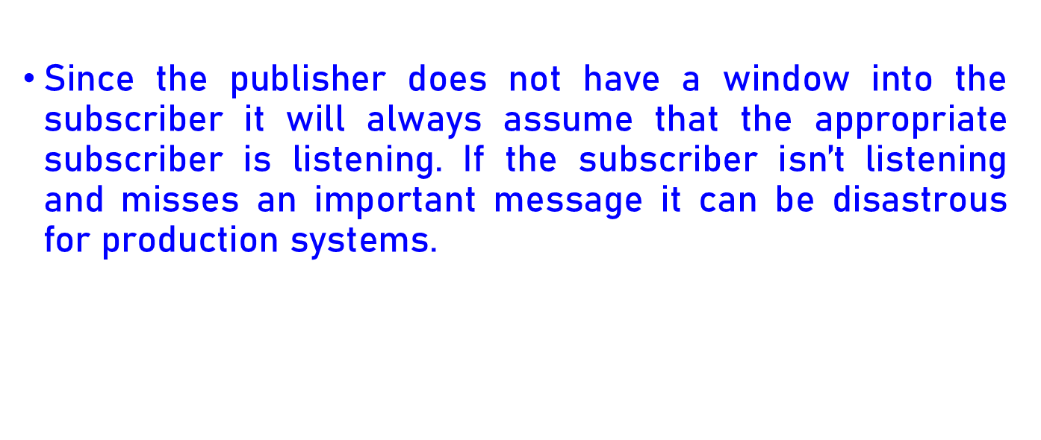
Continue….

Slide 16
Thank
You

